Slide 1
Object Oriented Design & Programming
Unit-2 Programming Basics OODP

Slide 2
🞄 Input Stream: If the direction of flow of bytes is from device(for example Keyboard) to the main memory then this process is called input.
🞄 In C++ input and output is performed in the form of sequence of bytes or more commonly known as streams.
Input / Output Stream
🞄 Output Stream: If the direction of flow of bytes is opposite, i.e. from main memory to device( display screen ) then this process is called output.
🞄 iostream: It stands for standard input output stream. This header
file contains definitions to objects like cin, cout etc.

Slide 3
🞄 The data needed to be displayed on the screen is inserted in the standard output stream (cout) using the insertion operator (<<).
🞄 For Example:
Standard Output stream (cout)
#include <iostream>
using namespace std;
int main( )
{
cout<< “Welcome to Marwadi University”;
return 0;
}

Slide 4
🞄 The extraction operator (>>) is used along with the object cin for reading inputs. The extraction operator extracts the data from the object cin which is entered using the keyboard.
🞄 For Example:
Standard Input Stream (cin)
#include<iostream> using namespace std; int main()
{
int id;
cout<< "Enter your id:"; cin>> id;
cout<< “\n Your id is: "<<id;
return 0;
}

Slide 5
🞄 Smallest individual unit of a program is called Token.
🞄 There are 5 types of token in C++ :
Tokens
Keywords
Identifiers
Strings
Constants
Operators

Slide 6
🞄 In C++, keywords are reserved identifiers which cannot be used
as names for the variables in a program.
Keyword
🞄 Keywords cannot be used for the –
Declaring Variable Name
Declaring Class Name
Declaring Function Name
Declaring Object Name

Slide 7
Keyword
asm | double | new | switch | auto | else
operator | template | break | enum | private | this
case | extern | protected | throw | catch | float
public | try | char | for | register | typedef
class | friend | return | union | const | goto
short | unsigned | continue | if | signed | virtual
default | inline | sizeof | void | delete | int
static | volatile | do | long | struct | while
bool | true | false | using | namespace | wchar_t

Slide 8
🞄 Various data items with symbolic names in C++ is called as Identifiers.
🞄 Following data items are called as Identifier in C++ :-
Names of functions
Names of arrays
Names of variables
Names of classes
Identifiers
🞄 Each language has its own rules for naming the identifiers. The
following rules are common to both C and C++:
🞄 Only alphabetic characters, digits and underscores are permitted.
🞄 The name cannot start with a digit.
🞄 Uppercase and lowercase letters are distinct.
🞄 A declared keyword cannot be used as a variable name.
🞄 While ANSI C recognize 32 characters in a name, ANSI C++
places no limit on its length.

Slide 9
🞄 Constants are the items whose value cannot be changed during
the program execution.
🞄 Like C, C++ serves several kinds of literal constants.
🞄 wchar_t type is a wide-character literal introduced by ANSI C++ and is intended for character sets that cannot fit a character into a single byte. Wide-character literals begin with the letter L.
🞄 C++ constants include character, string, integers, floating point
numbers.
Constants
123 // decimal constant | 0X2 // Hexadecimal constant
12.34 // floating point constant | “C++” // String Constant
O37 // octal constant | ‘A’ // Character constant
L ‘ab’ // wide character constant introduced by ANSI C++

Slide 10
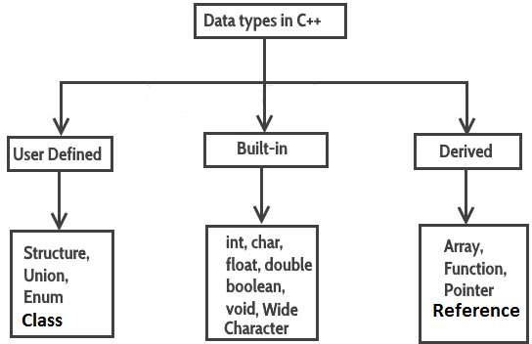
Data Types

Slide 11
Size and Range of data types
Data type | Size (bytes) | Range
char | 1 | -128 to 127
unsigned char | 1 | 0 to 255
short int | 2 | -32,768 to 32,767
unsigned short int | 2 | 0 to 65,535
int | 2 | -32,768 to 32,767
long int | 4 | -2147483648 to 2147483647
unsigned long int | 4 | 0 to 4294967295
float | 4 | 3.4E-38 to 3.4E+38 (~7 digits)
double | 8 | 1.7E-308 to 1.7E+308 (~15 digits)
long double | 10 | 3.4E-4932 to 1.1E+4932
bool | 1 | -

Slide 12
🞄 Syntax:
bool variable_name;
🞄 Example:
bool b;
🞄 In C++, the data type bool has been introduced to hold a Boolean
value, true or false.
🞄 The default numeric value of true is 1 and false is 0.
Boolean Data type

Slide 13
🞄 Global variable
🞄 Local variable
#include<iostream>
using namespace std;
int main()
{
cout<<global<<"\n"<<::global;
return 0;
}
//global variable
int global = 10;
Variables
// Local variable with the same name as global
int global = 20;

Slide 14
name for an existing variable.
🞄 When a variable is declared as reference, it becomes an alternative
🞄 A variable can be declared as reference by putting ‘&’ in the
declaration.
🞄 Syntax:
🞄 Datatype &reference_name = variable_name
🞄 For example:
float total = 100; float &sum = total;
Reference Variables

Slide 15
using namespace std;
#include<iostream>
x
10
int main()
{
int x = 10;
int & ref = x;
ref
Example
ref = 20; // Value of x is now changed to 20
cout << "x = " << x << endl ;
x = 30; // Value of x is now changed to 30
cout << "ref = " << ref << endl ;
return 0;
Output: 20
30
}

Slide 16
🞄 To create user defined type names the keyword enum is used.
🞄 An enumeration is set of named integer constants.
🞄 An enumerated data type provides a way to attach name to the numbers. The keyword enum automatically enumerates the list of words by assigning 0,1,2… and so on.
🞄 Syntax: enum name {List of names} variables;
🞄 Example:-
enum color { red , green, blue};
color background; // background is type of color
background = blue; // allowed background = 7; // Warning in C++ background = (color) 7; // OK
Enum

Slide 17
Where by default value of Circle is =0 Rect=1 and Tri =2
🞄 enum a {Circle, Rect, Tri};
Enum Examples
🞄 enum a {Circle=1, Rect, Tri};
Where by default value of Circle is =1 Rect=2 and Tri=3
🞄 enum a {Circle=2, Rect=6, Tri=4};
Where by default value of Circle is =2 Rect=6 and Tri=4

Slide 18
#include <iostream> using namespace std;
enum week { Sunday, Monday, Tuesday, Wednesday, Thursday, Friday,
Saturday };
int main()
{
week today;
today = Friday;
cout << "Day " << today;
return 0;
}
// Output: Day 5
Enum Example

Slide 19
Operators
Type | Operators
Arithmetic | +, -, *, /, %
Relational | <, >, < =, >=, = =, !=
Logical | &&, | |
Assignment | =
Bitwise | &, ^, |
Increment Decrement | ++, --
Conditional (Ternary) | ? :
Special operators | Comma (,) , sizeof, dot(. ) , - >

Slide 20
New Operators in C++
Operators | Description
: : | Scope resolution operator
: :* | Pointer-to-member declarator
- >* | Pointer-to-member operator
.* | Pointer-to-member operator
new | Memory allocation operator
delete | Memory release operator
setw | Field width operator
endl | Line Feed operator

Slide 21
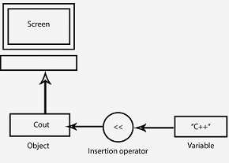
🞄 The operator << is called the insertion or put to operator.
🞄 It inserts (or sends) the contents of the variable on its right to the
object on its left.
🞄 Operator << is the bit-wise left-shift operator and it can still be
used for this purpose.
🞄 This concept is known as operator overloading, an important
aspect of polymorphism.
Insertion Operator

Slide 22
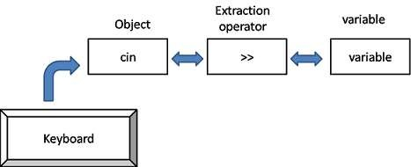
🞄 It extracts (or takes) the value from the keyboard and assigns it to
🞄 The operator >> is known as extraction or get from operator.
the variable on its right.
🞄 Operator >> is the bit-wise right-shift operator and it can still be
used for this purpose.
Extraction Operator

Slide 23
🞄 Like C, C++ is also a block-structured language. Blocks and scopes
🞄 Use1: To access global version of data
can be used in constructing programs.
Scope Resolution Operator
🞄 Same variable name can be used to have different meanings in
different blocks.
🞄 The scope of the variable extends from the point of its
declaration till the end of the block containing the declaration.
🞄 Scope resolution operator allows access to the global version of
a variable.
🞄 This can be used to uncover a hidden variable.
🞄 Syntax:
:: variable-name

Slide 24
#include<iostream>
using namespace std;
int x = 10;
Scope Resolution Operator
int main()
{
int x = 20;
cout<<“The value of local x is:”<<x<<"\n“; cout<<“The value of global x is:”<<::x; return 0;
}
Output
20
10

Slide 25
🞄 Use2: To access member of class
🞄 A major application of the scope resolution operator (::) is to
identify the class to which a member function belongs.
Scope Resolution Operator
#include<iostream> using namespace std; class A { public: // Only declaration void fun(); }; | void A::fun() { cout<< "fun() called"; } int main( ) { A a; a.fun(); return 0; }

Slide 26
🞄 Type conversion occurs when the expression has data of mixed data types. Example of such expression include converting an integer value into a float value.
🞄 In type conversion, the data type is promoted from lower to higher because converting higher to lower involves loss of precision and value.
🞄 double>float>long>int>short>char
🞄 Ex:
Type Conversion
int a = 3, b = 2;
float c;
c = a * b;
cout<<c; // value of c = 6.00

Slide 27
#include<iostream>
using namespace std;
int main()
{
bool b = true; char c = 'a'; short s = 4056; int i = 50000; float f = 5.67; double d= 0.123; double result = cout<<result; return 0;
}
Output:
float + int – double = double 21.782
Type Conversion Example
float * boolean -> float
int / char -> int
(f * b) + (i / c) - (d * s);
double * short -> double

Slide 28
🞄 It is also known as explicit type conversion.
🞄 Explicit type conversions can be forced in any expression to change the type by programmer.
🞄 Syntax:
(type-name) expression; OR type-name (expression);
🞄 Ex:
Type Casting
short a;
float c=4264.56789;
a=(short)c;
cout<<a; // value of a = 4264
int a=5,b=2, c=6;
float d;
d= float (a+b+c) / 3;
cout<<d; // value of d = 4.33333
🞄 In first example, it will convert the value of c to a short value
before assigning to a, but c is not altered actually.

Slide 29
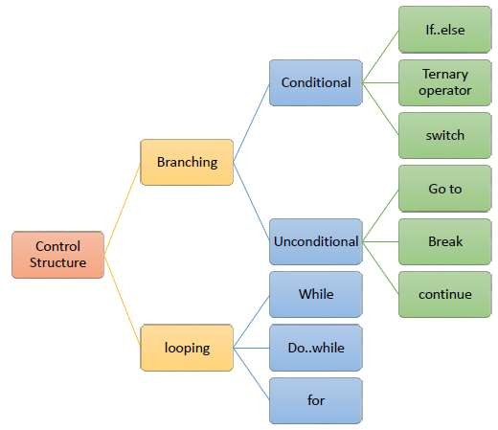
Control Structures

Slide 30
If condition
Example:-
#include<iostream> using namespace std; int main() { int age; if(age>18) { cout<<“he is eligible for voting”; } return 0; }
Syntax:-
if (condition) { ……………….. ……………….. }

Slide 31
If Else Condition
Example:-
#include<iostream> using namespace std; int main() { int age; if(age>18) { cout<<“he is eligible for voting”; } else { cout<<“he is not eligible for voting”; } return 0; }
Syntax:-
if (Condition) { ………….. } else { ………… ………… }

Slide 32
Nested if else
Example:-
if(a>b) { if(a>c) { cout<<"\n a is greatest: -"; } else { cout<<"\n c is greatest: -"; } } else { ……….. }
Syntax:-
if (……….) { …………. …………. if (………) { ………….. } else { …………… } }

Slide 33
Ladder else if condition
Syntax:-
if (……….) { …………. } else if (…….) { ………… } else if (………) { …………. } else { …………. }
Example:-
If(a==b) { cout<<“a is equal to b”; } else if(a>b) { cout<<“a is greater”; } else { cout<<“b is greater”; }

Slide 34
statement.
🞄 The switch case statement is also known as multi way decision
🞄 The switch statement test the value of a given variable against a list of
case values.
Syntax:-
switch (<selector expression>) { case <label1> : <sequence of statements>; break; case <label2> : <sequence of statements>; break; . case <labeln> : <sequence of statements>; break; default : <sequence of statements>; break; }
Switch Case Condition

Slide 35
Switch Case Condition
Example:-
#include <iostream> using namespace std; int main () { char grade = ‘A'; switch(grade) { case 'A' : cout<< "Excellent!" << endl; break; case 'B’ : cout<< “V.good”<<endl; break; return 0; }

Slide 36
any desired position within a program
🞄 This statement is used to send the control from one position to
Syntax:-
int main () { Label: ----- ------ ------- goto Label; ---------- ---------- --------- }
Example:-
int main () { int n=1; xyz: cout<<n; n++; goto xyz; return 0; }
Goto Label Condition

Slide 37
condition satisfied.
🞄 A loop is a group of statements that are executed until some
🞄 The loop consists two segments:
Body of the loop:
🞄 This segment consists single or group of statements.
Control statements:
🞄 The control statement consists the condition.
Loop Structure

Slide 38
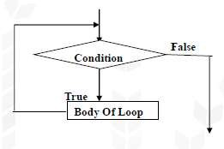
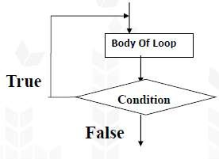
🞄 Two types of Loop structure:
Entry Control:
🞄 If the condition is checked before body of loop then it is known as entry controlled loop.
Exit Control:
🞄 If the condition is checked after body of loop then it is known as
exit controlled loop.
Loop Structure
Entry control
Exit control

Slide 39
🞄 It has a loop condition only that is tested before each iteration to
decide whether to continue or terminate the loop
Example:-
int main() { int i=0; while(i<3) { cout<<“Hello \n”; i++; } return 0; } Output: Hello Hello Hello
Syntax:-
while (<condition>) { <statement/block>; }
While Loop

Slide 40
🞄 Initializer is executed at start of loop.
🞄 For loop has three parts:-
🞄 Loop condition is tested before iteration to decide whether to
continue or terminate the loop.
🞄 Increment/decrement is executed at the end of each loop
iteration.
Syntax:-
for (initialization; condition; increment or decrement ) { body of loop; }
Example:-
for(i=0; i<3; i++) { cout<<“Hello \n”; }
For Loop

Slide 41
🞄 Do while has a loop condition only that is tested after each iteration to decide whether to continue with next iteration or terminate the loop.
Example:-
int main() { int i=1; do { cout<<“Hello \n”; i++; } while (i<3); return 0; } Output: Hello Hello Hello
Syntax:-
do { <statement/block>; }while(condition);
Do While Loop

Slide 42
🞄 The break statement is used to terminate the loop.
🞄 When the break statement is encounter in the loop, the loop is exited and the control will transfer out of that loop.
🞄 The break statement can be used with while loop, do….while loop and for loop.
Break Statement
for(i=1; i<=5; i++)
{
if(i== 3)
{
break;
}
else
{
cout<<i;
}
}
Output:
1 2

Slide 43
🞄 The continue statement causes the loop to skip the statements followed by it in the loop and goes to the iteration (step).
🞄 The continue statement does not terminate the loop but it only
skips the statements followed by it.
🞄 The continue statement can be used with for loop, while loop and
do….while loop.
Continue Statement
for(i=1;i<=10;i++)
{
if(i%2==0)
continue;
else
cout<<i;
}
Output:
1 3 5 7 9

Slide 44
🞄 We use dynamic allocation techniques when it is not known in
advance, how much of memory space is needed.
🞄 In C, functions such as malloc(), calloc( ), realloc( ) are used to dynamically allocate memory and free( ) is used to free dynamically allocated memory.
Memory management operators
🞄 C++ supports two additional unary operators new and delete that perform the task of allocating and freeing the memory in a better and easier way.
🞄 Since these operators manipulate memory on the free store, they
are also known as free store operators.

Slide 45
delete, as and when required.
🞄 An object can be created by using new, and destroyed by using
Memory management operators
🞄 A data object created inside a block with new, will remain in
existence until it is explicitly destroyed by using delete.
🞄 Thus, the Lifetime of an object is directly under our control and is
unrelated to the block structure of the program.

Slide 46
following way:
🞄 The new operator can be used to create objects of any type in the
🞄 pointer-variable = new data-type;
🞄 Example:
p = new int;
q = new float ;
🞄 Here, p and q must have already been declared as pointers of appropriate types.
🞄 Alternatively, we can combine the declaration and allocation.
Operator “New”
int *p = new int;
float *q = new float ;
*p = 25;
*q = 7.5;

Slide 47
pointer-variable = new data-type(value);
🞄 We can also initialize the memory using the new operator.
🞄 Here the value specifies the initial value.
int *p = new int (25);
float *q = new float (7.5) ;
🞄 new can be used to create a memory space for user-defined types such as arrays, structures and classes. The general form for a one- dimensional array is:
pointer-variable = new data-type[size];
🞄 Here, size specifies the number of elements in the array
Operator “New”

Slide 48
🞄 Example: int *p = new int[10];
🞄 p[0] will refer to the first element, p[1] to the second element, and
so on.
🞄 When creating multi-dimensional arrays with new, all the array sizes must be supplied.
Operator “New”
array_ptr= new int[3][5][4]; array_ptr= new int[m][5][4]; array_ptr= new int[3][5][ ]; array_ptr= new int[ ][5][4];
// legal
// legal
// illegal
// illegal
🞄 The first dimension may be a variable whose value is supplied at
runtime. All others must be constants.

Slide 49
2000
char *ptr; ptr = new char;
*ptr = ‘B’;
cout<< *ptr;
5000
ptr
Operator “New”
5000
‘B’

Slide 50
🞄 When a data object is no longer needed. it is destroyed to release the
memory space for reuse.
🞄 delete pointer-variable;
🞄 Here, pointer-variable is the pointer that points to a data object
created with new.
🞄 Examples:
delete p;
delete q;
Operator “delete”
🞄 To free a dynamically allocated array:
delete[size] pointer-variable;
🞄 The size specifies the number of elements in the array to be freed.
🞄 Programmer should remember the size of the array.
🞄 Recent versions of C++ do not require the size to be specified.
🞄 Example: delete [] pointer-variable; //will delete the entire
array pointed to by p.

Slide 51
p = (int*) malloc(sizeof(int));
p = new int;
Advantages of new over malloc ( )
It automatically computes the size of the data object. We need not use the operator sizeof.
It automatically returns the correct pointer type, so that there
is no need to use a type cast.
It is possible to initialize the object while creating the memory
space.
Like any other operator, new and delete can be overloaded.

Slide 52
🞄 Manipulators are operators that are used to format the data display.
🞄 The most commonly used manipulators are endl and setw.
🞄 The endl manipulator, when used in an output statement, causes a
linefeed to be inserted.
🞄 It has the same effect as using the newline character "\n".
🞄 Example: following statement would cause three lines of output.
🞄 cout<< “m = “ << m << endl
<< "n = " << n << endl
<< "p = " << p << endl;
Manipulators

Slide 53
🞄 If we assume the values of the variables as 2597, 14, and 175 respectively, the output will appear as:
m = | 2 | 5 | 9 | 7
n = | 1 | 4
p = | 1 | 7 | 5
🞄 It is important to note that this form is not
the ideal output. It should rather appear as:
m = | 2 | 5 | 9 | 7
n = |  |  | 1 | 4
p = |  | 1 | 7 | 5
Manipulators
🞄 The numbers are right-justified. This form of output is possible only if we can specify a common field width for all the numbers and force them to be printed right-justified.

Slide 54
🞄 Setw manipulator does this job.
cout<< setw(5) << sum << endl;
🞄 The manipulator setw(5) specifies a field width 5 for printing the
value of the variable sum.
🞄 If value of sum is 345 then output will be:
Manipulator setw
 |  | 3 | 4 | 5
🞄 This value is right-justified within the field.

Slide 55

#include<iostream>
#include <iomanip> // for setw using namespace std;
int main()
{
int basic=950, allowance=95, total=1045;
cout<<setw(10)<<“Basic ”<<setw(10)<<basic<<endl; cout<<setw(10)<<“Allowance ”<<setw(10)<<allowance<<endl; cout<<setw(10)<<“Total ”<<setw(10)<<total<<endl;
return 0;
}
setw Example

Slide 56
🞄 Syntax: setfill(char_type c);
#include <iostream> #include <iomanip> using namespace std;
int main()
{
string s = “Ankita";
// setfill is $ and width is set as 10 cout<< setfill('$') << setw(10); cout<< s << endl;
Manipulator setfill
// setfill is * and width is set as 10
// left is used set s to left side
cout<< left << setfill('*') << setw(10); cout<< s << endl;
return 0;
Output:
$$$$Ankita
Ankita****
}

Slide 57
🞄 Syntax: setprecision (int n);
#include <iostream> #include <iomanip> using namespace std;
int main ()
{
double f =3.141592653589793238;
cout << setprecision(5) << f << '\n'; cout << setprecision(9) << f << '\n';
Manipulator setprecision
Output:
3.1416
3.14159265
3.14159
3.141592654
cout << fixed;
cout << setprecision(5) << f << '\n'; cout << setprecision(9) << f << '\n'; return 0;
}

Slide 58
🞄 Syntax: setbase (int base);
🞄 Base 10 -> for decimal
🞄 Base 16 -> for hexadecimal
🞄 Base 8 -> for octal
#include <iostream> #include <iomanip> using namespace std;
Manipulator setbase
int main()
{
// set base to hexadecimal
cout<< setbase(16);
// displaying 14 in hexadecimal cout<< 14 << endl;
}
Output:
e

Slide 59
Thank you

